Slide 1
Today’s Agenda
Overview of syllabus (favorite things)
Trends in use of methods and programs for data analysis
Graphs of nonlinear effects (Lewis-Beck and Lewis-Beck 2015)
Applications of non-linear effects
Household income effects on child well-being (Kerris and Stewart 2021)
Machine leaning (Bruno et al. 2022)
Specifications of independent variables in real time applying OLS regression to state-level data
Categorical variable
Numeric variable
Interactions between categorical and numeric variables
Guidelines for quantitative publications (Mustillo et al. 2018)
Overview of Assignment 1

Slide 2
Use of methods in demographic research
Machine learning methods
Unsupervised
Supervised
Binary logistic regression models
Interpretation of logit models
Odds ratios
Average marginal effects
Multinomial and ordered logit models
Complex survey design
Multilevel models
Fixed effects models
Economics
Sociology
Random effects and hybrid models
Imputation of missing data

Slide 3
Use of programs in demographic research
SPSS
SAS and SUDAAN
Stata
R (recent job advertisements for demographers / sociologists)
Have you used any of these programs? What about other programs?

Slide 4
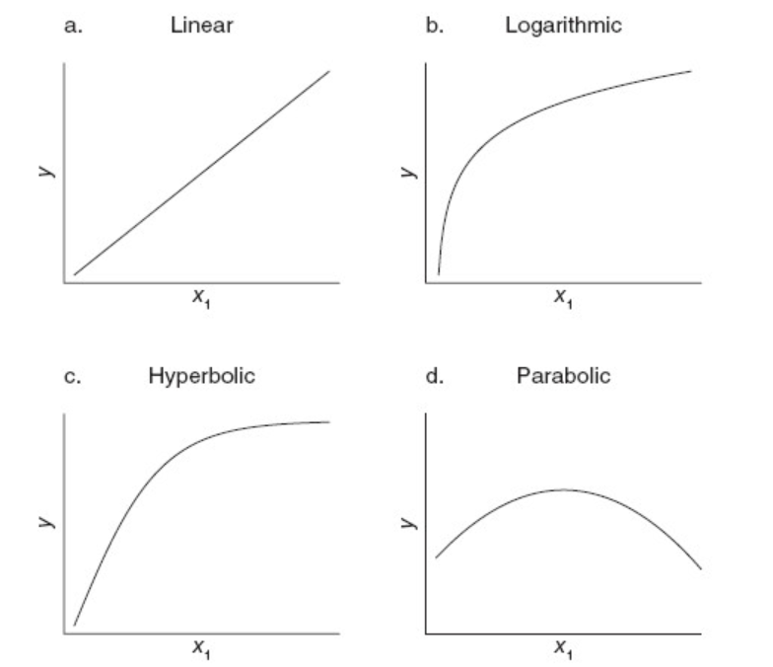
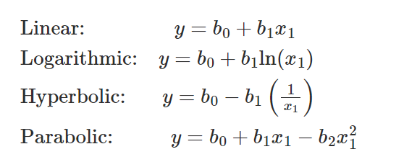
Estimating non-linear effects

Slide 5
Guidelines for quantitative publications
Thresholds for statistical significance
Tests of mediation
Coefficients for interaction terms in models with categorical dependent variables
Use of terms multivariable versus multivariate
Ad hoc specifications of variables or scales (cherry-picking)
Methods sections
Omitted details
Organization

Slide 6
Specifications of variables in real time
Expanded version of Junkins et al. (2022) state-level data
DV: Average age at first marriage
IVs:
Region of country
Share of state Evangelical Protestant or LDS
Results and interpretation

Slide 7
Overview of Assignment 1
1) Make sure RStudio is version 2022.12.0 Build 353, if not, update it
2) Make sure R is version 4.2.2, if not, update it
3) Run these commands:
>source("https://raw.githubusercontent.com/coreysparks/Rcode/master/install_first_7283.R")
>update.packages(ask=F)
4) Take a screen shot of your Rstudio window, showing the version of R at 4.2.2. See my example on the next slide.
5) Modify the Rmarkdown file to include your name, email address, and location & name of your screenshot. You will need to download it from Week 1.

Slide 8
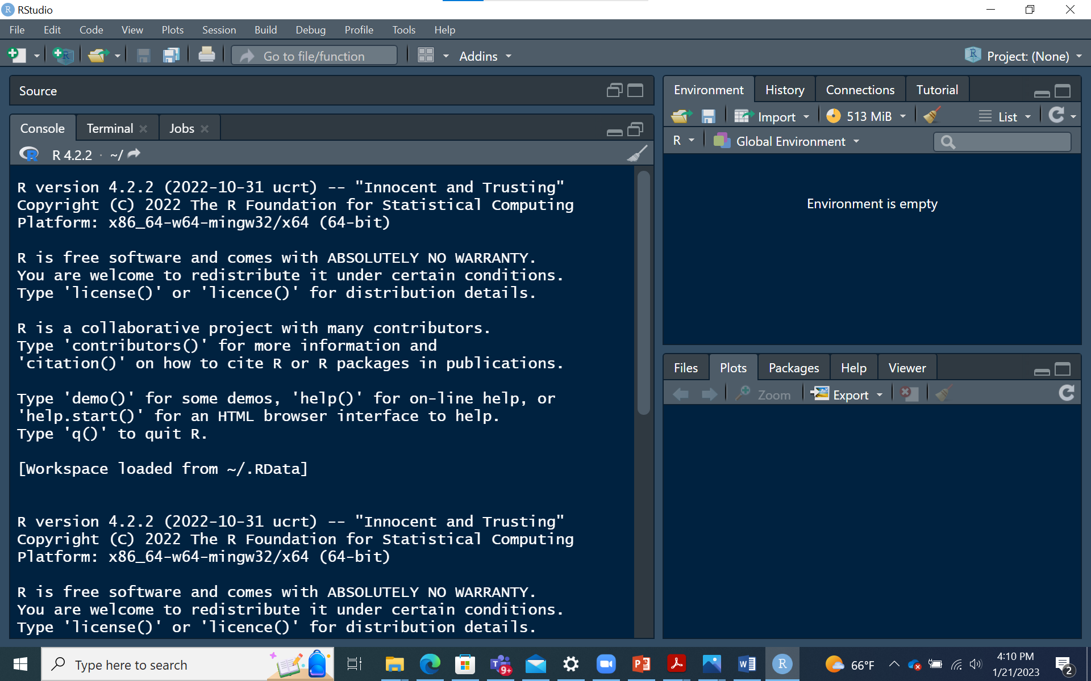

Slide 9
Overview of Assignment 1 (continued)
6) Specify the location of the excel file used in lecture. You will need to download it from Week 1.
7) Click on Knit. (Be sure your Excel file is not open.)
8) Publish your document by clicking on Publish in the upper right corner. (You will need to sign into Rpubs first.)
9) Copy and past the link to your document under Assignment 1 in Blackboard before the start of the next class.
10) Interpret the results within your Markdown file.
If you get stuck set up a Zoom call with me. Start this assignment ASAP.

Slide 10
Tips for Success in this Class
Read the material before class.
Start working on the assignment the day after class.
Spend some time every day reading the material and programming in R.
Use google searches for solutions in R, including the error messages.

